Slide 1

Tesla Stock Performance Analysis [A Review of Trends and Yearly Returns]
Aman Pahuja
December 29, 2023

Slide 2
Executive Summary
Tesla, as a dynamic player in the Electric Vehicle (EV) market, has garnered considerable attention for its innovative approach. This analysis delves into historical stock data of TESLA INC. (TSLA) collected from Kaggle, aiming to discern patterns in Tesla's stock performance and trading volume.
The analysis follows a structured methodology, covering data collection, wrangling, exploratory data analysis, and data visualization. Insights gained from this analysis contribute to a deeper understanding of Tesla's stock performance and trading patterns.

Slide 3
Introduction
Brief overview of Tesla as a dynamic player in the EV market.
This dataset provides historical data of TESLA INC. stock (TSLA), is collected from Kaggle.
Purpose of analysis: To discern patterns in Tesla's stock performance and trading volume.

Slide 4
Methodology
Data Collection: sourced from Kaggle
Data Wrangling: Checking for Duplicates, Normalization, Dealing with Missing Values
Exploratory Data Analysis: Distribution, Outliers, Correlation
Data Visualization: Visualizing Data, Analyzing Relationships, Composition and Comparison
Dashboards using Power BI

Slide 5
Analysis Findings - Overall Trends
No discernible pattern in stock performance across days of the week or months.
Volume distribution consistent; no trend observed in trading volume.

Slide 6
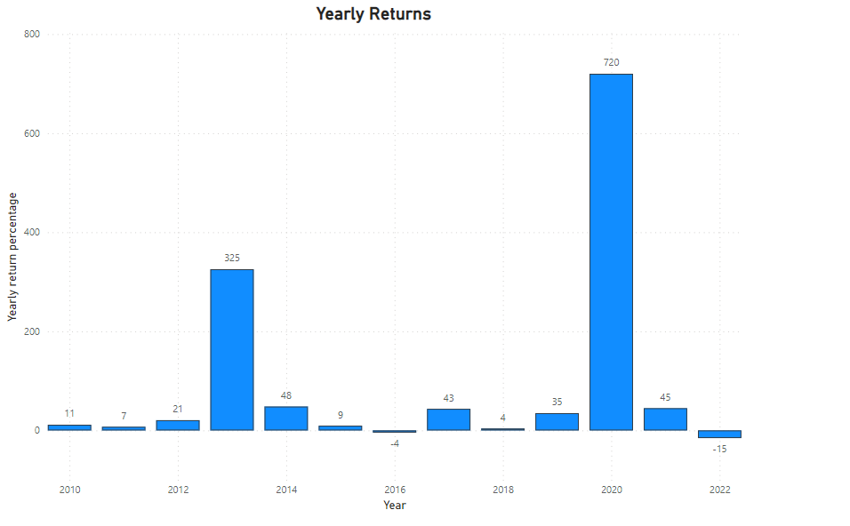
Analysis Findings - Yearly Returns
Exceptional returns noted in 2013 (325.42%) and 2020 (720%).
These peak performances were aligned with significant product launches and company milestones.

Slide 7
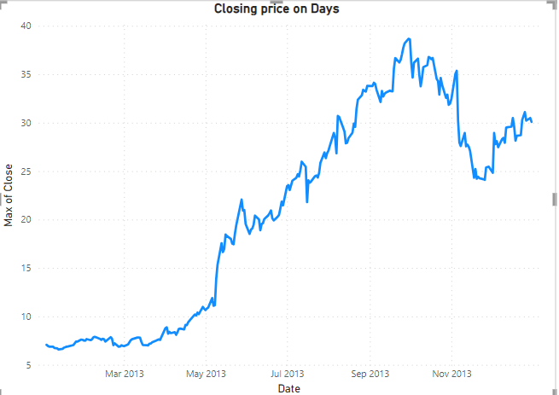
2013: Tesla's Milestones and Market Triumph
First profitable quarter reported, exceeding analyst expectations.
Model S receives safety clearance, boosting investor confidence.
Broad public and media attention contributes to stock popularity.

Slide 8
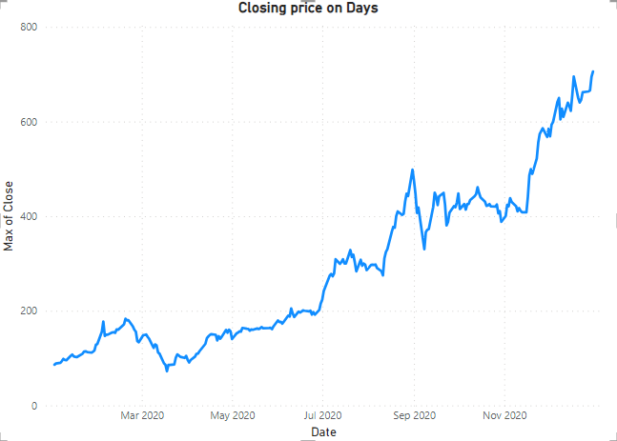
2020: Tesla's Technological Leap Forward
Innovative software architecture enabling ongoing performance optimization.
Expansion of Supercharger network underpinning EV long-distance travel.
Near achievement of Level 5 autonomy signaling a future of self-driving vehicles.
Introduction of the 4680-battery cell aimed to significantly cut costs.

Slide 9
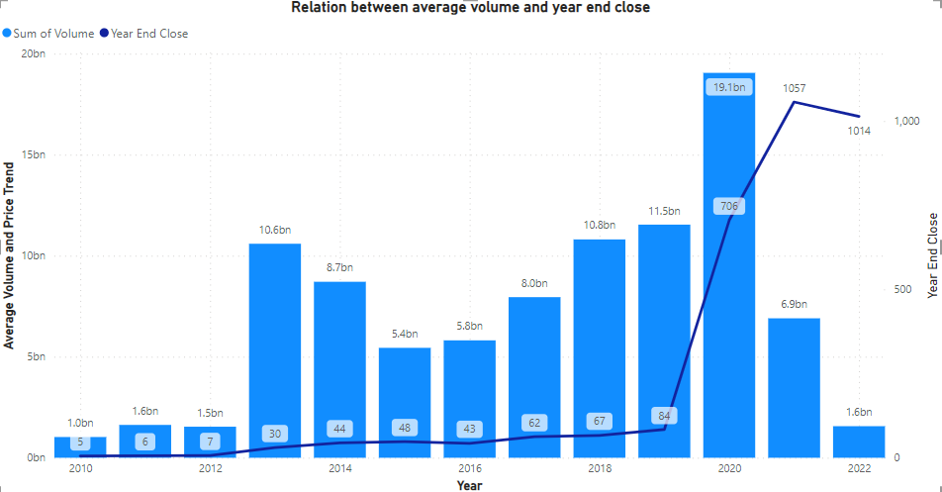
Discussion
The extraordinary returns in 2013 and 2020 were largely influenced by impactful Tesla news and global events.
2020's significant growth and volatility highlighted by the market's response to Tesla's strategic moves.

Slide 10

Conclusion
Tesla's stock exhibited a lack of clear and consistent patterns in its day-to-day performance, making it challenging to predict based on historical trends alone.
Investors are advised to pay close attention to Tesla's product launches, innovations, and corporate news as these factors emerged as critical drivers affecting stock performance.

